Slide 1
MARKET BASKET ANALYSIS – R shiny
Visualization using r shiny
By veera shubhashree – d19035

Slide 2
Brief of market basket analysis
Data mining technique to understand customer behavior better.
Association rules are formed by having a support and confidence thresholds(which are defined by the business use case)
Support of an item/item set is the fraction of transactions in the data set that contain that item or item set.
Confidence is the percentage of transactions in A B, containing A, that also contain B.

Slide 3

Visualization using r shiny
R Shiny allows us to create an interactive dashboard to visualize and interpret the machine learning models.
Two major components are :
UI – defines the user interface of the dashboard
Server – defines the process that runs behind the UI
Used the “Groceries” dataset available on “arules” package in R

Slide 4
Implementation
The inputs and association rules functions are defined on the server page.
UI components comprises of selectInput(), numericInput() and radioInput() to get the required values of type of output,support, confidence and number of rules.
Shiny application makes it easy by rendering the input and output functions easily.
Attaching a read.me document to make the implementation simple and easy.

Slide 5
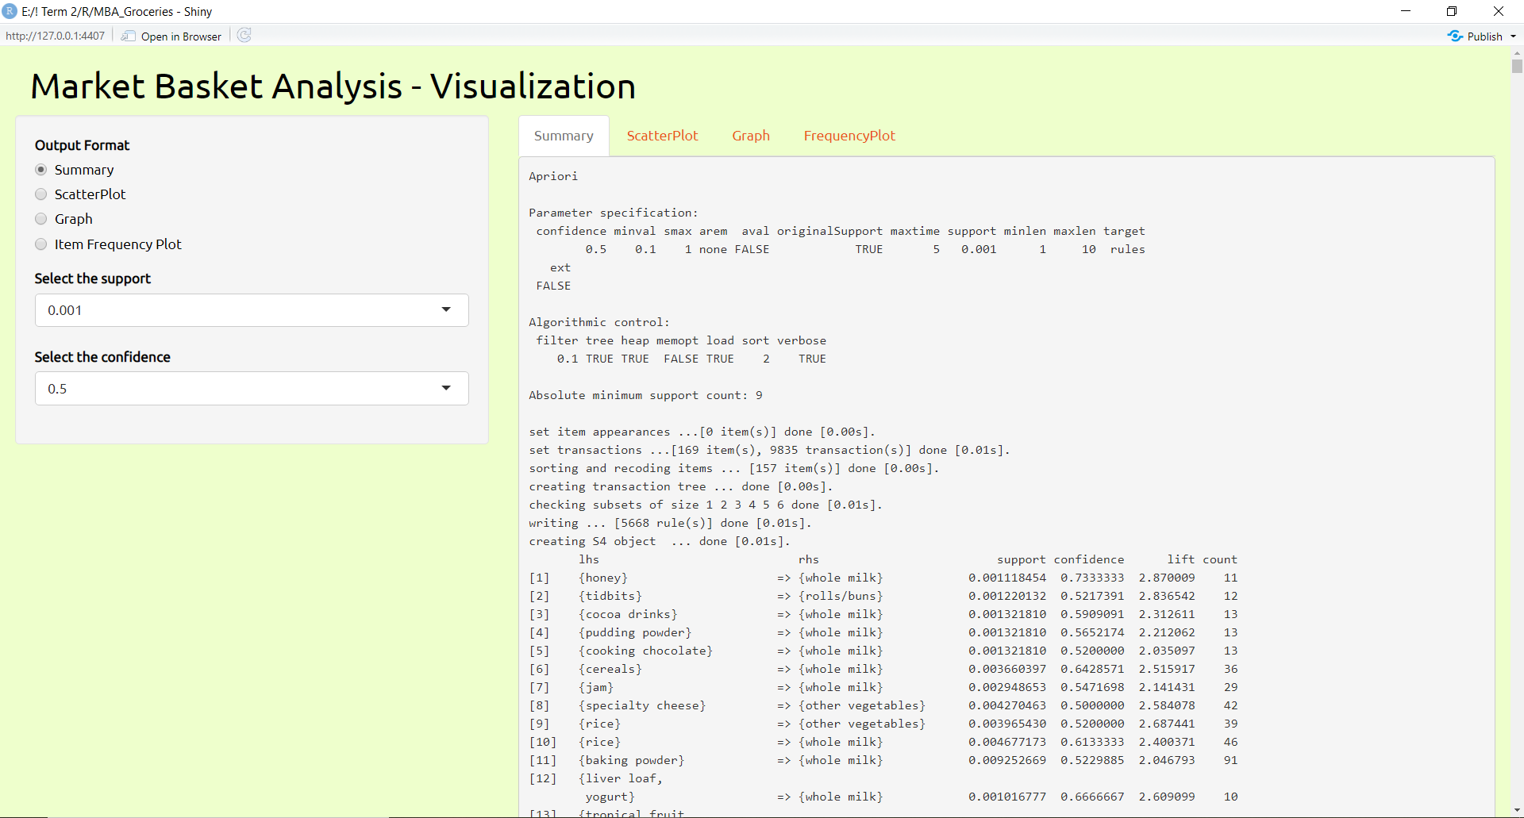
Visualization using r shiny - output
Select output format as ‘Summary’
Output Tab
Select required Support n Confidence from dropdown

Slide 6
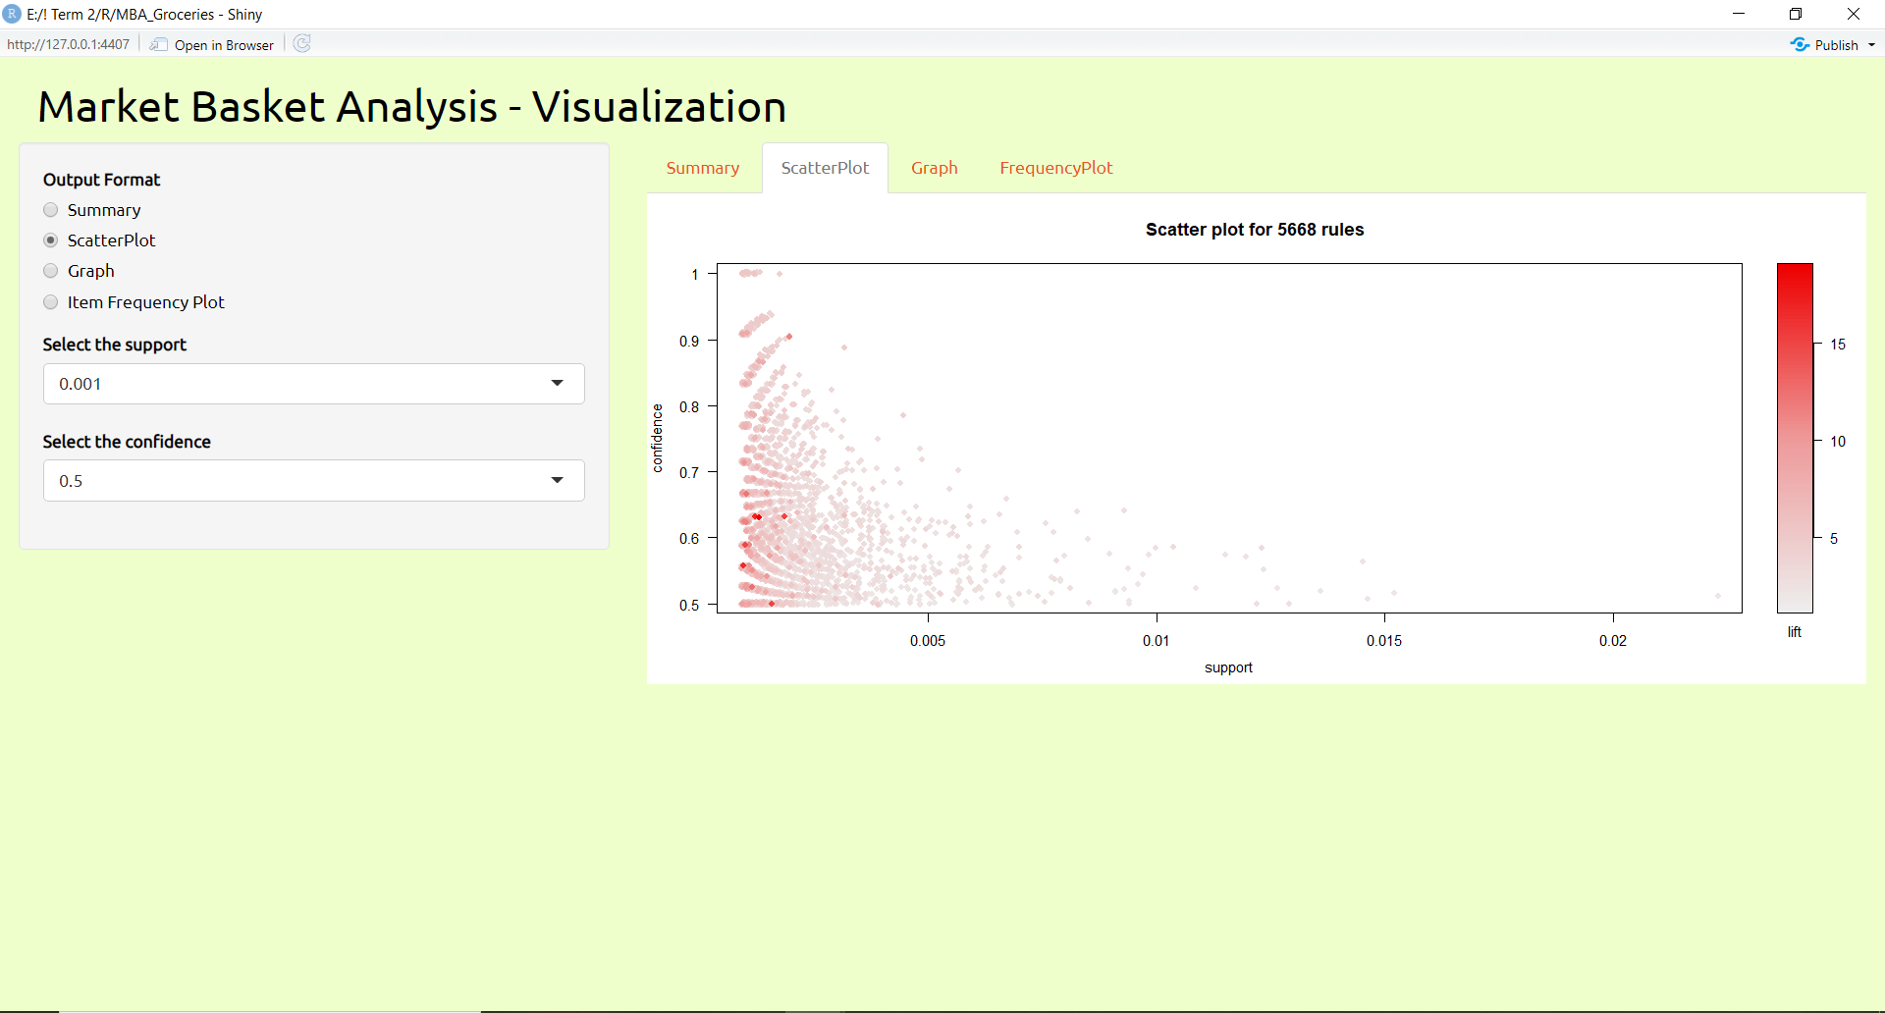
Visualization using r shiny - output
Select output format as ‘Scatter Plot’
Output Tab
Select required Support n Confidence from dropdown

Slide 7
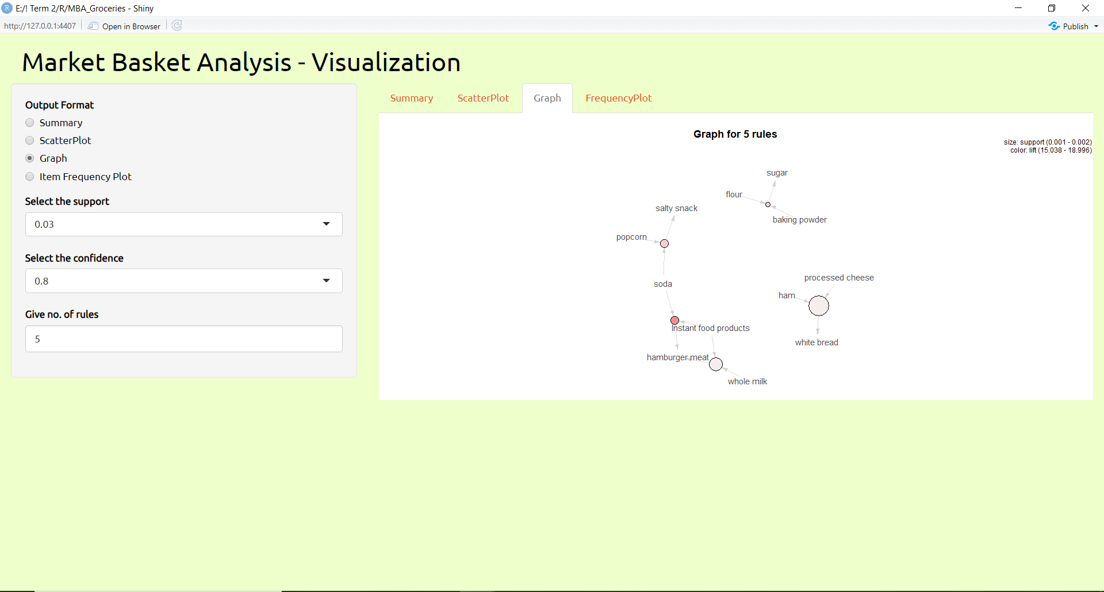
Visualization using r shiny - output
Select output format as ‘Graph’
Output Tab
Select required Support n Confidence from dropdown
Select the no. of rules
to be displayed
in Graph

Slide 8
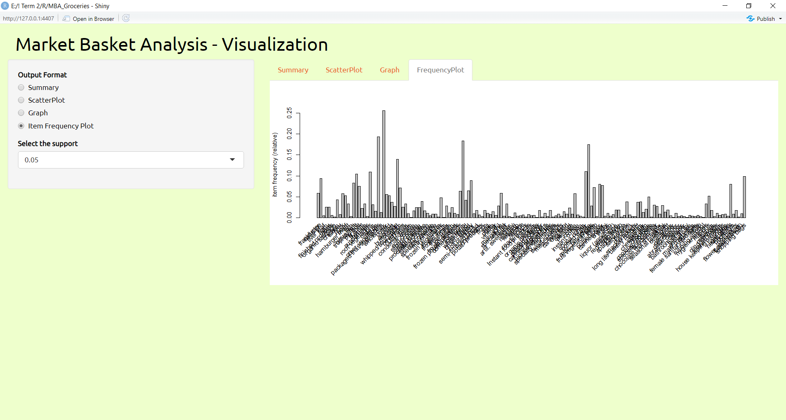
Visualization using r shiny - output
Output Tab
Select output format as ‘Item Frequency plot’
Select required Support from dropdown

Slide 9
Visualization using r shiny - output
To open app in Browser

Slide 10


